Slide 1
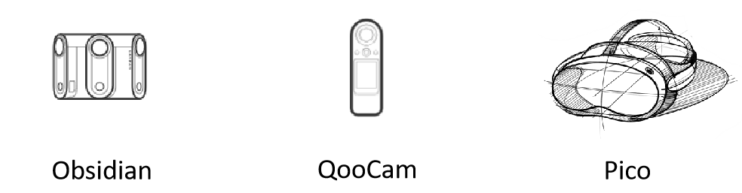

Project 04a
余宙峣 Yu,Zhouyao
辕首科技有限公司
A low cost and rapid construction of the panoramic teaching scheme
06.2023

Slide 2
Agenda
1. Background and Problem
2. Project Brief Introduction
3. Platfrom and Development tool
4. Control: 3 Dof IMU
5. Customized UI Component
6. Demonstration

Slide 3
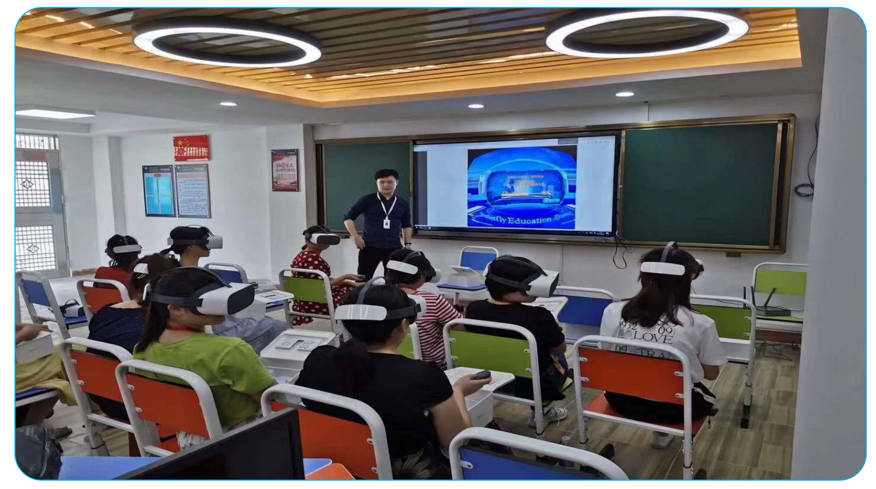
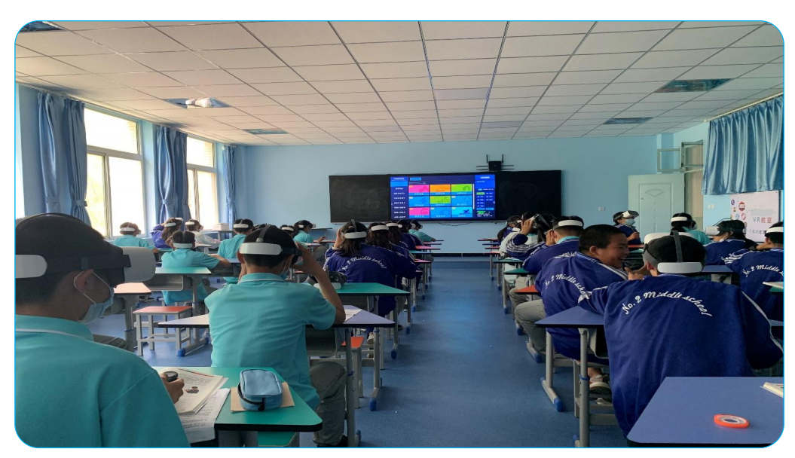
1. Background
1. Teaching with VR has been a hot topic since 2016
ZhongNing Second High School
Humen Chongya Primary School

Slide 4
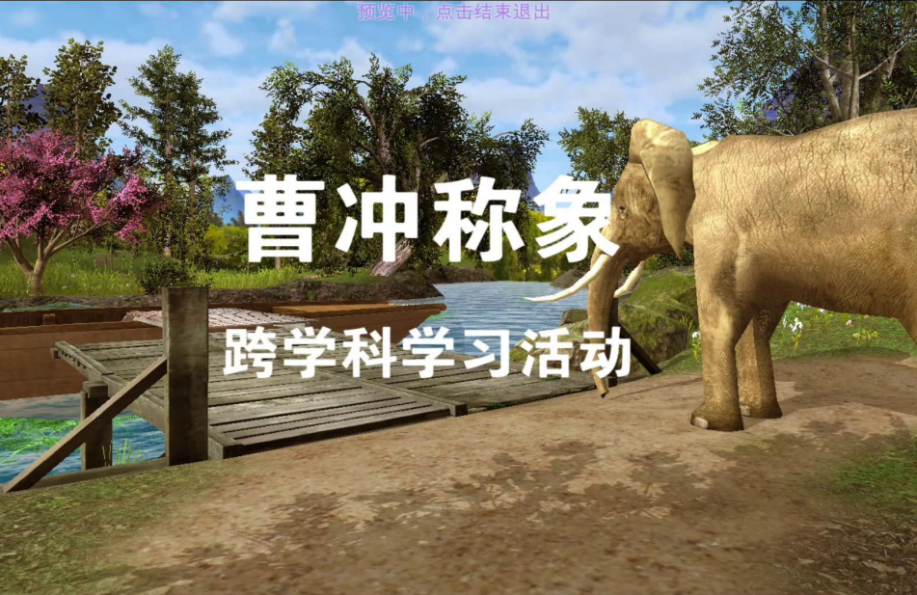
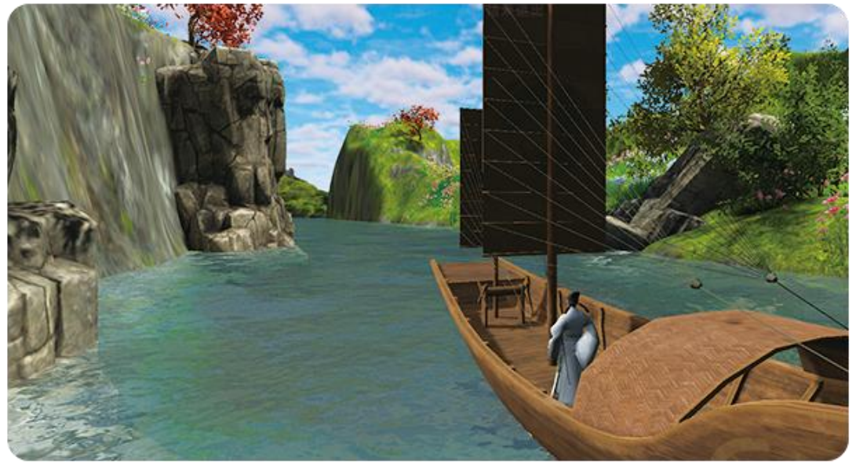
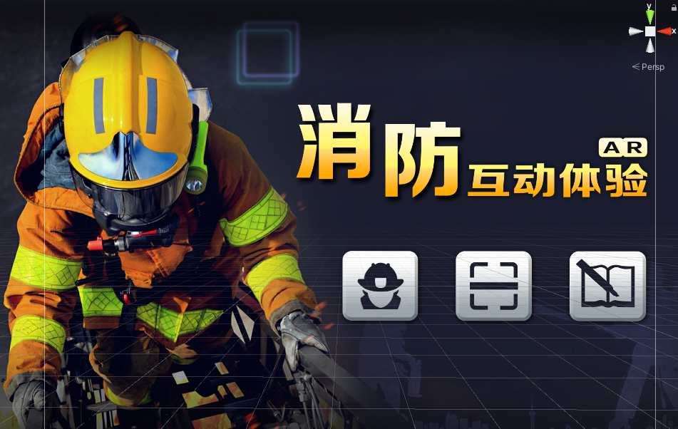
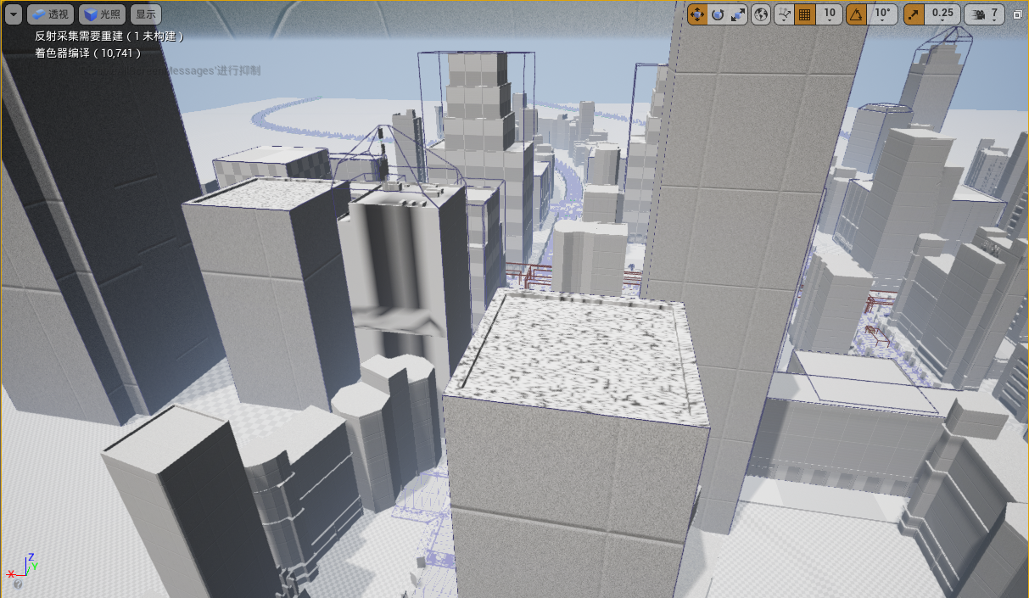
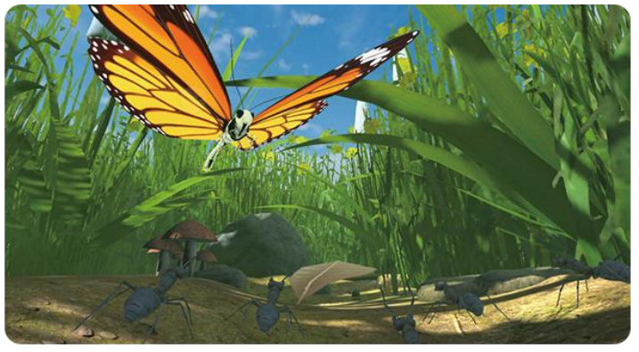
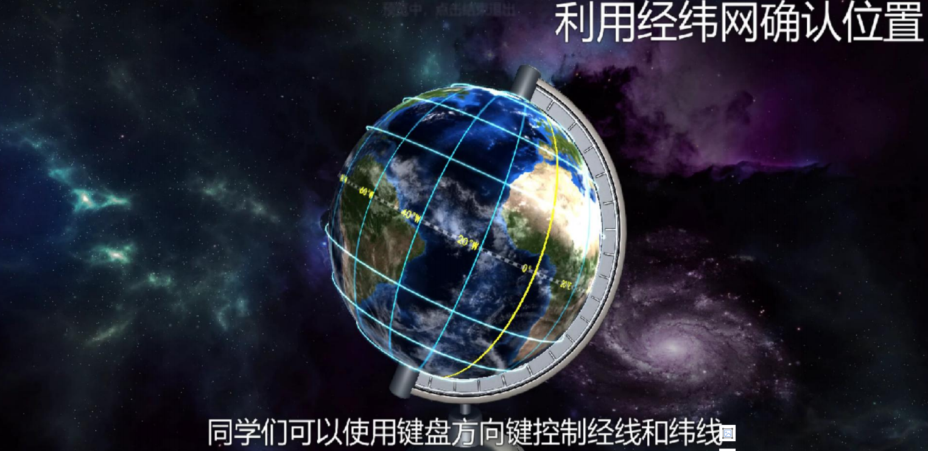
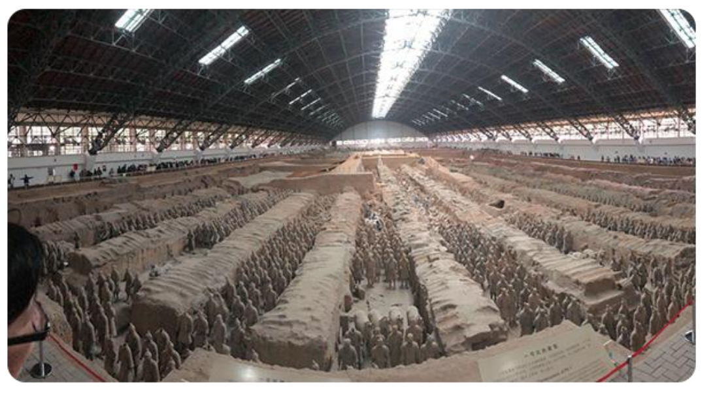
1. Background
2. Using VR for teaching is costly
Chinese Language and Literature Courseware
Safety Education Application
Science Courseware
Panoramic Photo

Slide 5
1. Problem and Holy Grail
Problem: Costly =>{
1. Labor-intensive and Professional Task
2. Highly Customized Development
3. Poor Reusability of Resources
}
Goal: To make courseware affordable through:
1. Easily Collected Resources
2. Reusable Resources
3. Non-professional Development

Slide 6
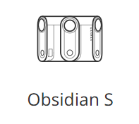
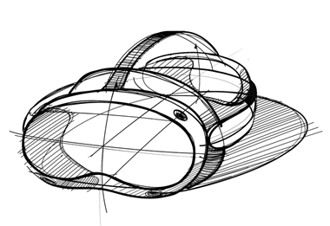

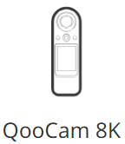
2. Brief Intro of Project
Collecting
Editing (04aEditor)
Playing (04aPlayer)
What is the Solution?
A workflow consisting of three parts,
1. a panoramic camera
2. a courseware editor
3. an interactive panoramic player
Image Rsc: https://www.51yuansu.com/sc/sjesxmzdnm.html

Slide 7
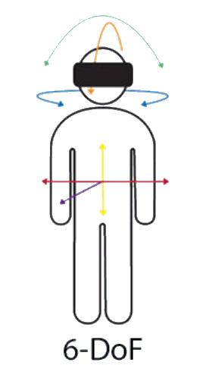
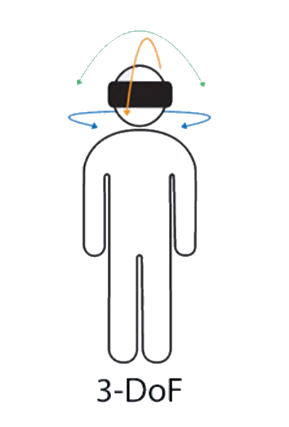
3. Platfrom and Development Tool
Hardware : Pico G2
1. Powered by Android
2. 3 Dof headset and controller
3. 3840 * 1920 for each lens
❌
✔
Software:
1. Android studio => Android platform building tool
2. Unity => Graphical interface
3. PicoVrSdk => Offering APIs for Pico G2
Image Rsc:https://virtualspeech.com/blog/degrees-of-freedom-vr

Slide 8

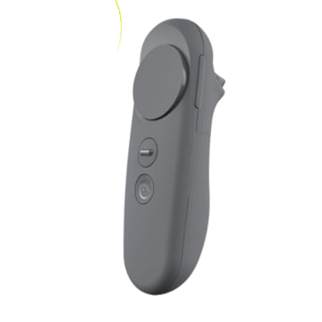
4. Control Method
Headset: IMU.Rotation(Input signal) -> Canmera.Transform.Rotation(Output signal)
Rotation Sensor
PicoVrSdk
Unity Camera
Synchronize
Controller: IMU.Rotation(Input signal) -> Controller.Transfrom(Output signal)
PicoVrSdk and Script
Calculate the Position and Rotation on Sphere
Rotation Sensor
Synchronize
Image Rsc: https://github.com/galazkap/Free-Camera-for-Unity
https://virtualspeech.com/blog/degrees-of-freedom-vr
https://item.gome.com.cn/A0007866374-pop8016795467.html

Slide 9
5. Customized UI Component
Unity / Android GUI components：
1. 2D
2. renderred on Camera
Anchor：
1. placed in 3D space
2. renderred as 3D object
Sketch :
Plane of Renderring
(Marked in red)
Anchor
(Marked in orange)
Other Costomized GUI:
(Marked in green)
1. Mask
2. Anchor selected indicator
3. Pointer indicator
3
Anchor
Functionality of Anchor：
1. displaying text
2. poping up image
3. swithing scene
2
1

Slide 10
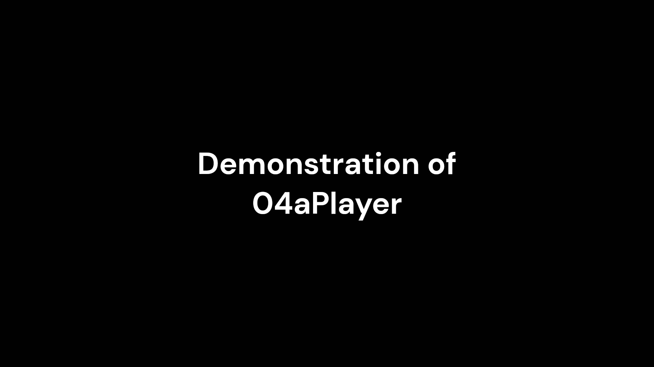
6. Demonstration

